Slide 1
Magist
A fitting partner in Brazil?
Presented by Imen, Lawrence, Jan and Sadia

Slide 2

The Main Objective
Is Magist a good fit for a tech products and heavily based on Apple-compatible accessories company like Eniac’s?
Are deliveries fast enough to keep Eniac’s customers happy?

Slide 3
Are deliveries fast enough to keep Eniac’s customers happy?

Slide 4
The Main Objective
1.
Is Magist a good fit for a tech products and heavily based on Apple-compatible accessories company like Eniac’s?
2.
Are deliveries fast enough to keep Eniac’s customers happy?

Slide 5
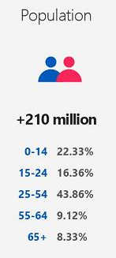
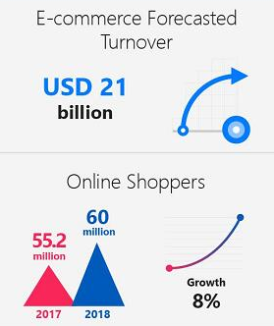
Why invest in Brazil ?
source : www.privacyshield.gov/ps/article?id=Brazil-e-Commerce

Slide 6
Magist’s Potential
1.2 million profits per months
32951 Products 3095 sellers
SHOP
More than 99.000 buyers
90% of delivery arrive on time

Slide 7
Are Magist’s Customers interested in Tech Product ?

Slide 8
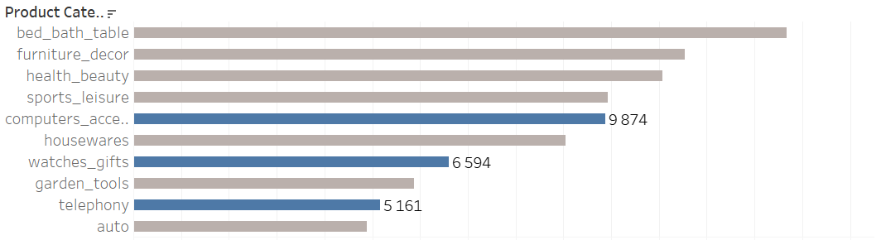
Are Magist’s Customers interested in Tech Products ?

Slide 9
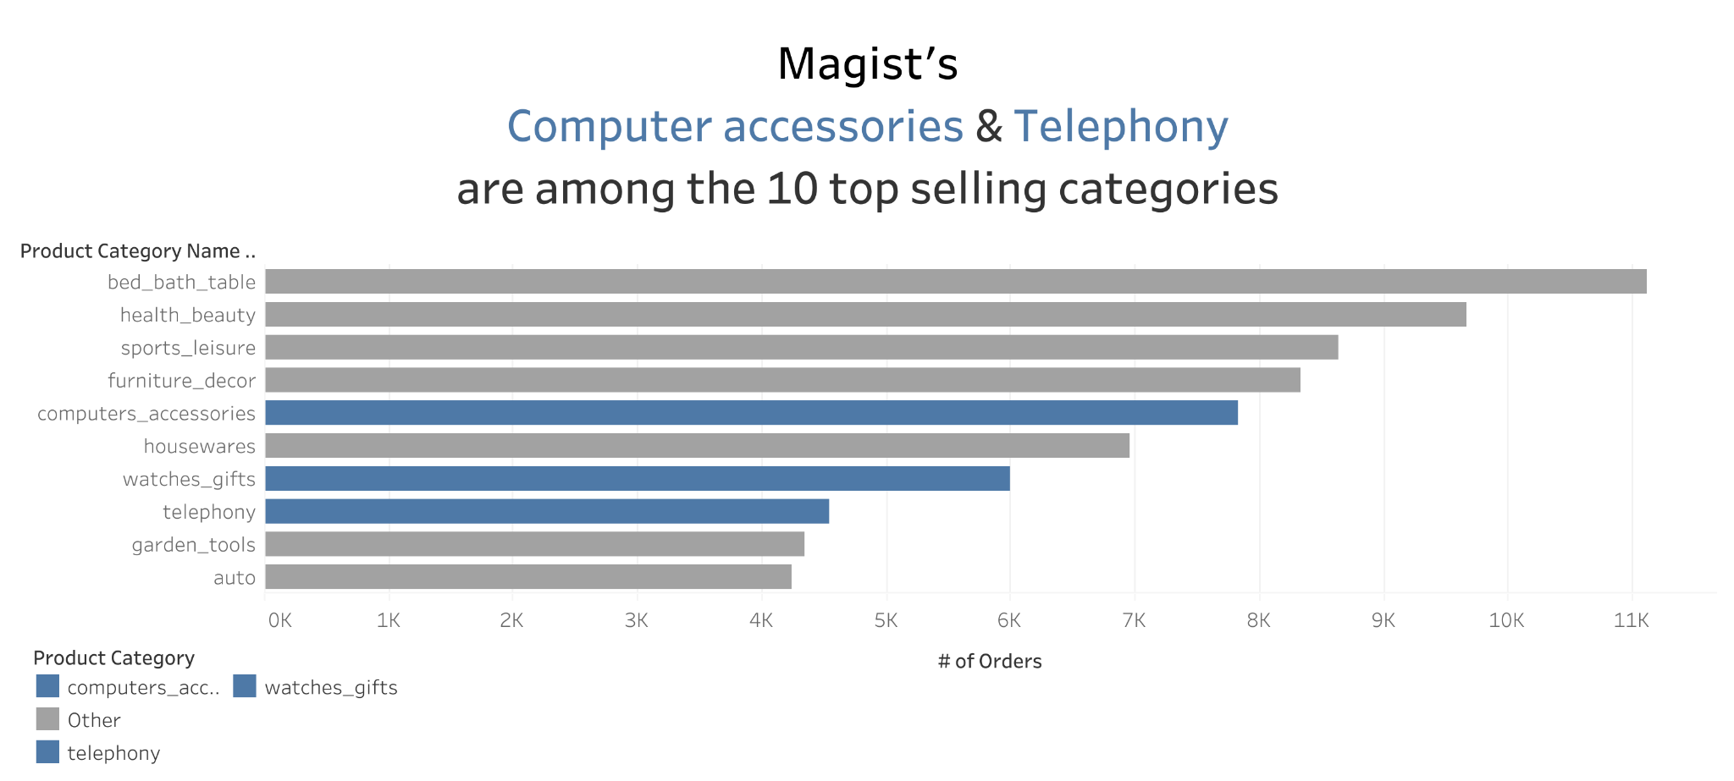

Slide 10
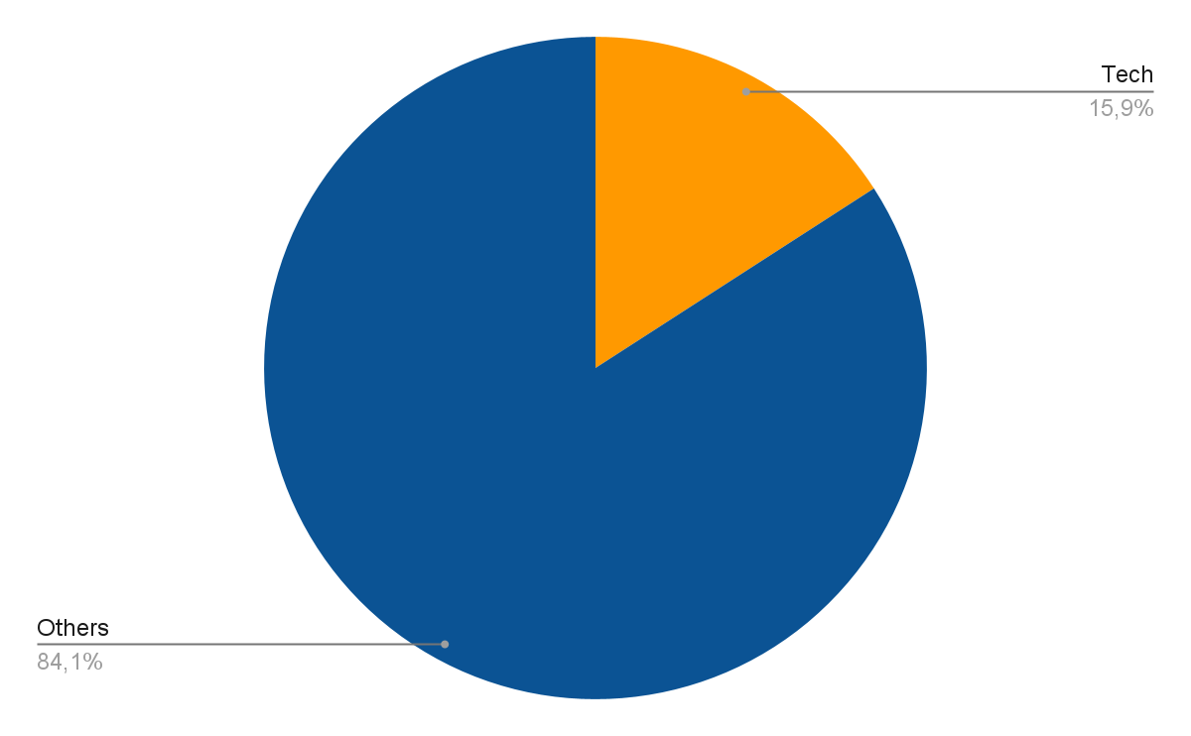
Total Sales
Notes:
can we make the words tech and others a lil
bigger? along with the percentage bigger?

Slide 11
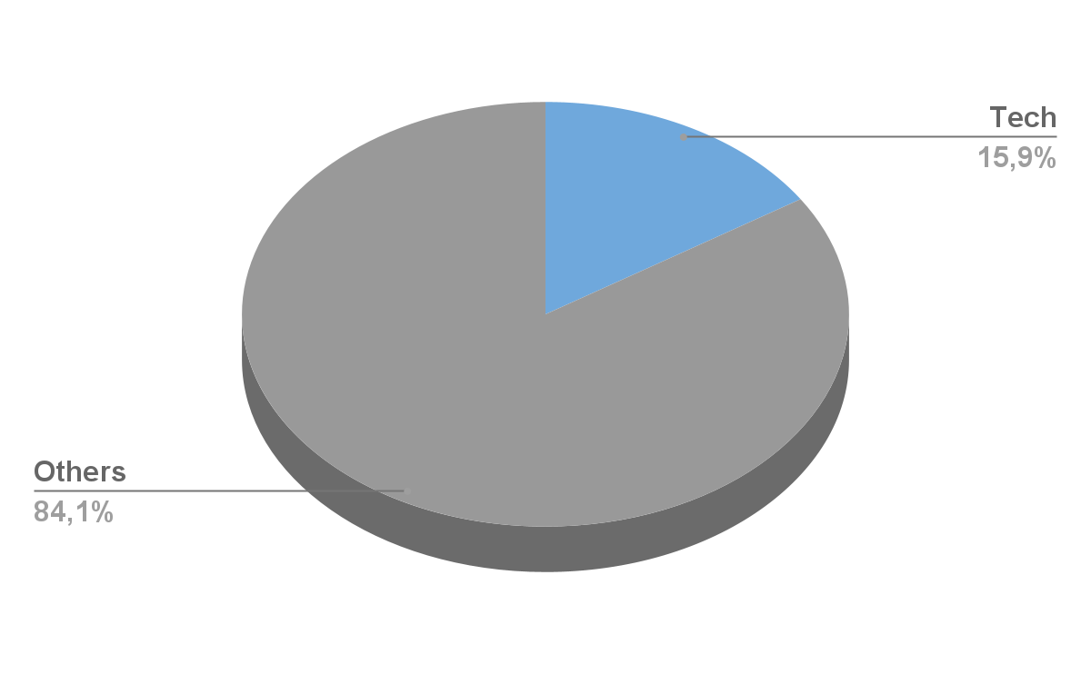
Total Sales of Technology Products

Slide 12
Purchasing Power of Magist’s Customers ?

Slide 13
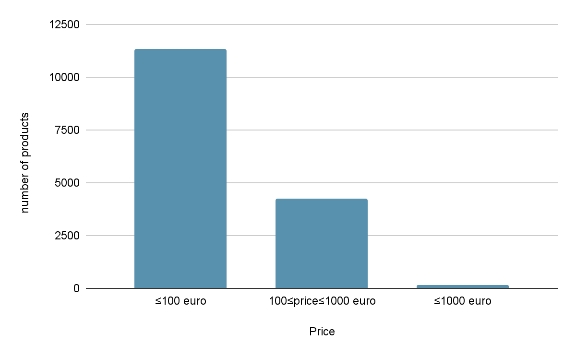
Price Range of Magist’s Products

Slide 14
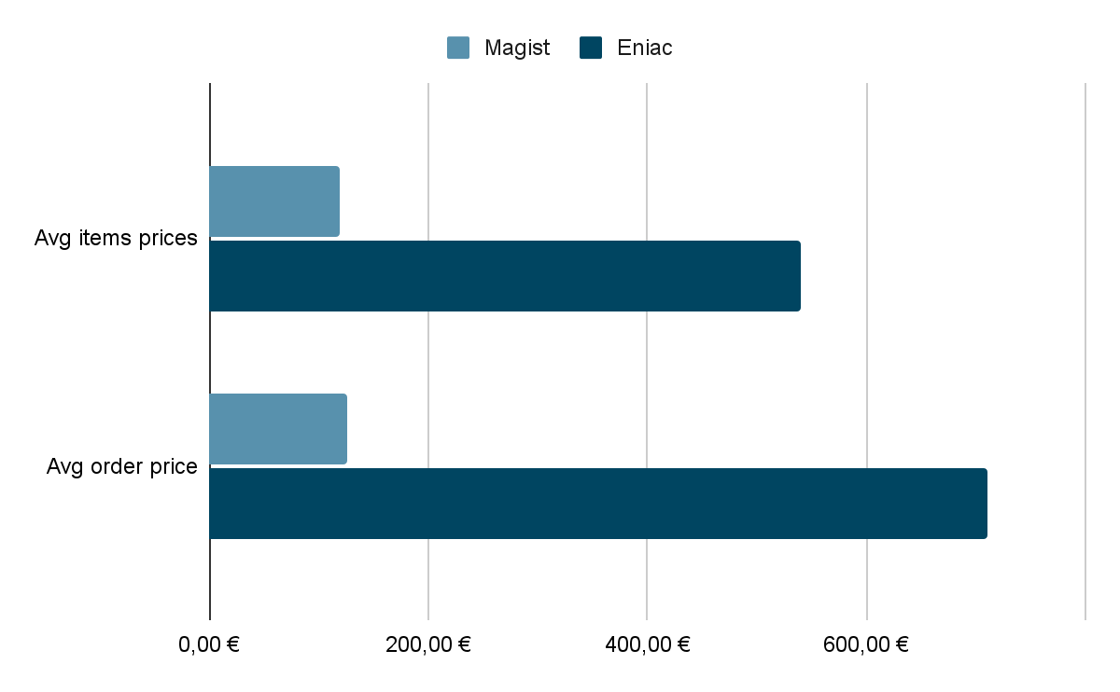
Difference in AVG prices
Notes:
Eniac Average price = 500 euro
magist Average purchase120 Euro

Slide 15
How satisfied are Magist’s Customers?
Average review Score:
4,08 out of 5

Slide 16
Delay on Product Delivery
Product Delivery | Number of Products
Delay | 9500
On Time | 89941

Slide 17
Delay on Product Delivery
10%
90%
products delivered delayed
products delivery on time
#9500
#89941

Slide 18
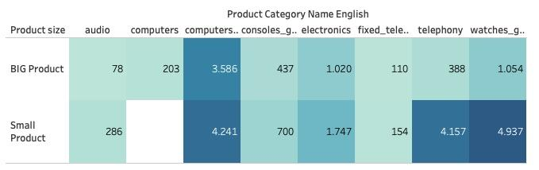
10% products are delivered delayed
The average delay for big products are 11.22 days

Slide 19
Major tech Products are in Bigger Volume
_{Products Volume>4000 cm3 =Big}
Vestibulum congue
45% Computer Accessories
Vestibulum congue
Vestibulum congue
71% fixed telephony
9,33% telephony

Slide 20
More delay in Bigger Products
11.2
when products are bigger in volume; product size>4000 cm3
days
products consists computer accessories, telephony, fixed telephony
delay
for smaller size products avg delay is 10 days

Slide 21
Summary
Pros:
Good customer satisfaction
Good overall delivery time
Acceptable % of delayed deliveries
Some experience handling tech-products
Cons:
Long delays for big products
Difference in AVG prices
small % of high-priced tech-products
Small customer base
Limited data provided by Magist

Slide 22
Recommendation
Consider looking for a more suitable partner
Alternatively: negotiate a contract with a trial period

Slide 23
Do you have any question ?

Slide 24
Appendix

Slide 25
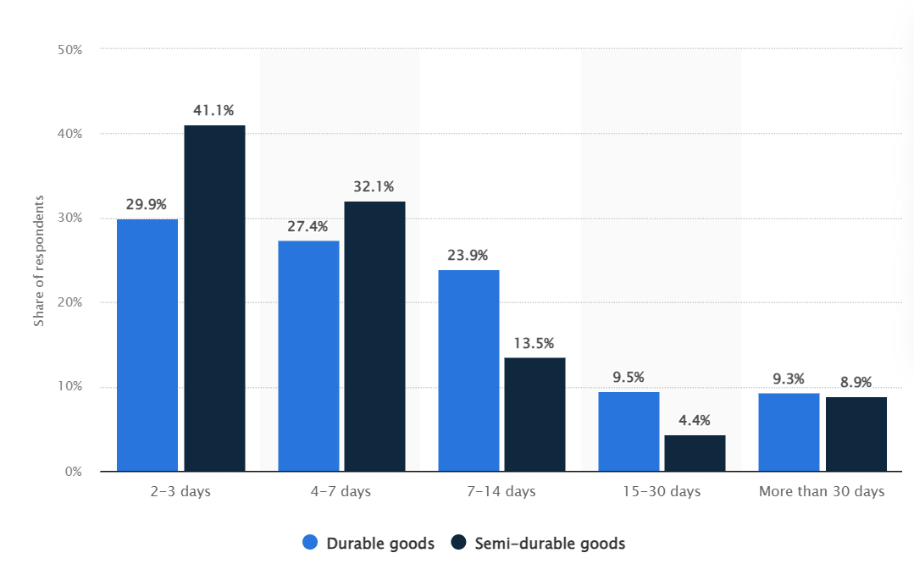
Maximum delivery time that digital buyers considered acceptable for online purchases in Brazil in 2017
https://www.statista.com/statistics/783442/e-commerce-brazil-maximum-delivery-time/

Slide 26
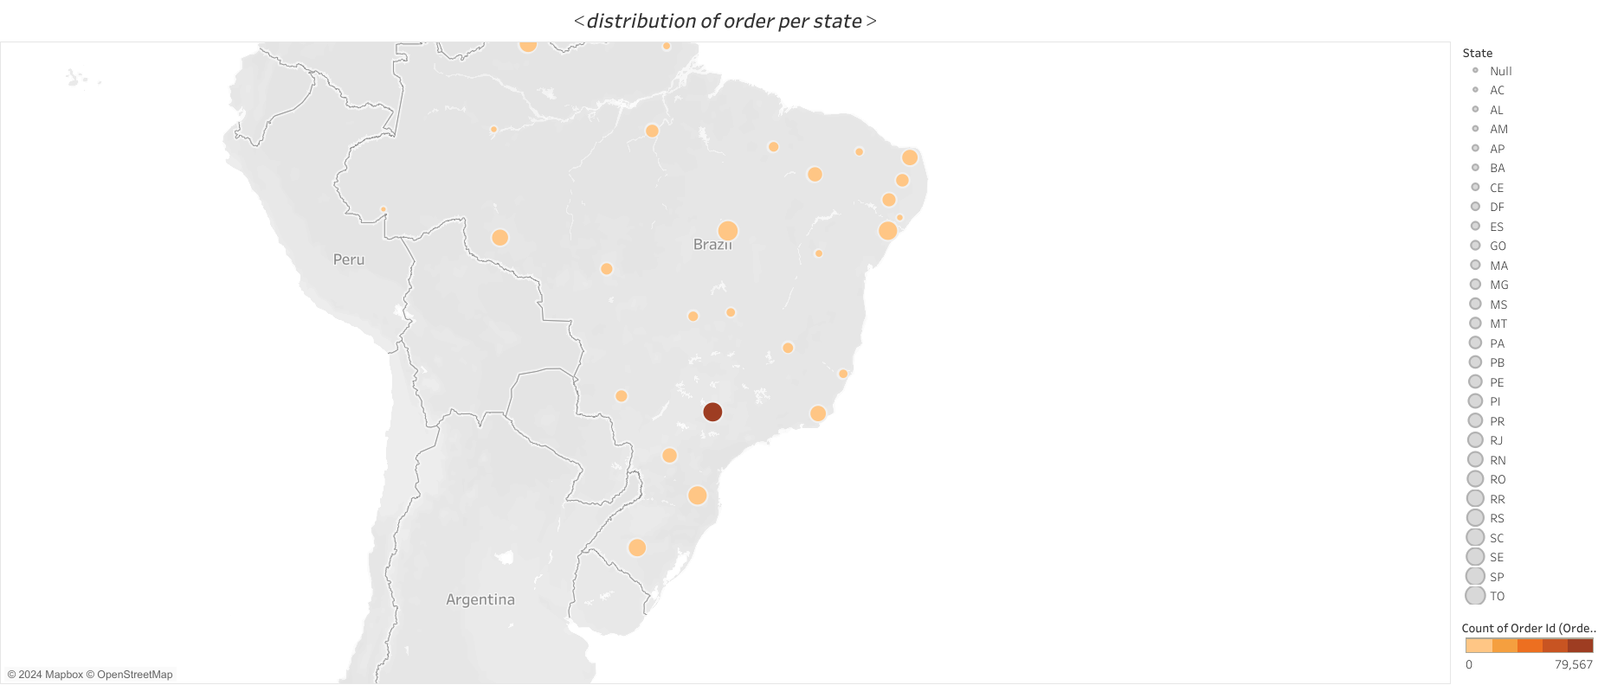

Slide 27
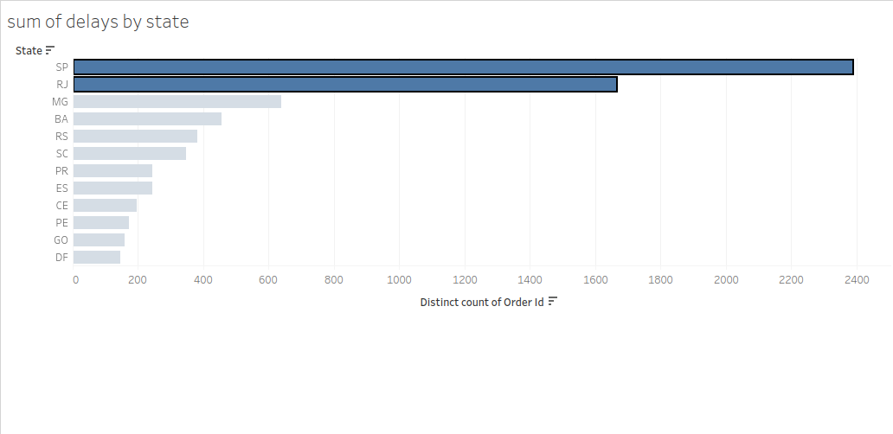

Slide 28
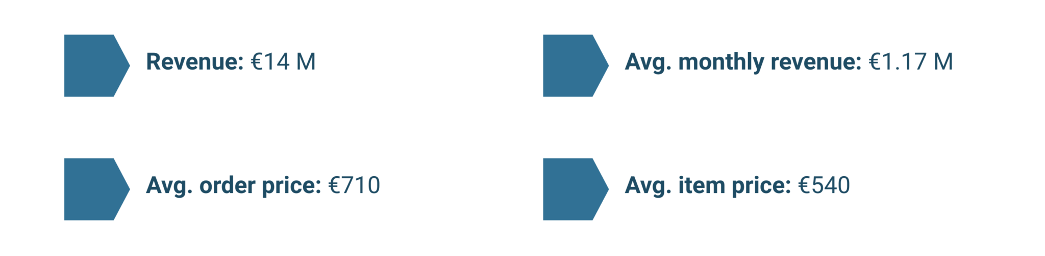
Eniac’s scope
(data from April 2017 to March 2018)

Slide 29
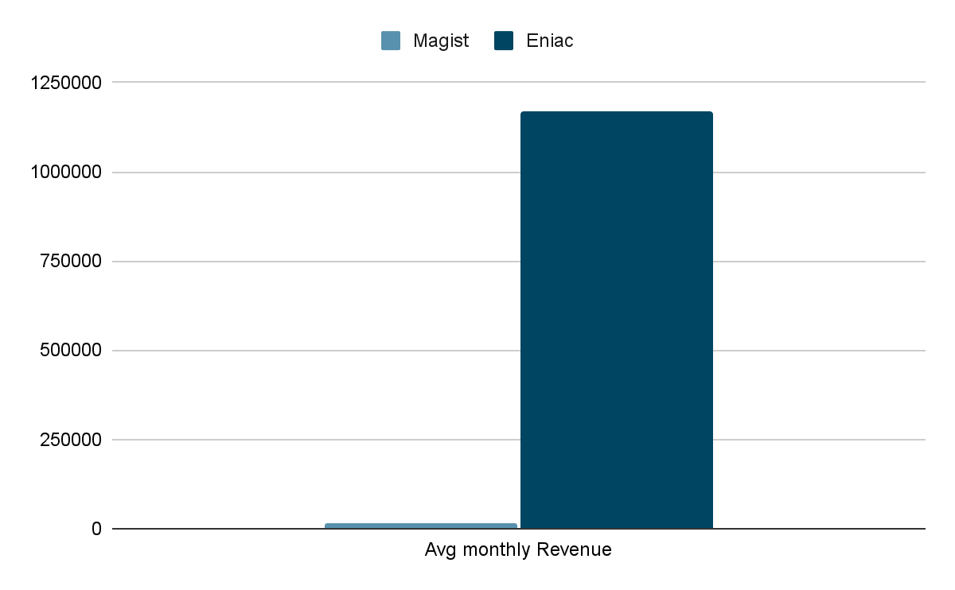
How much in average earn a tech seller with Magist ?

Slide 30
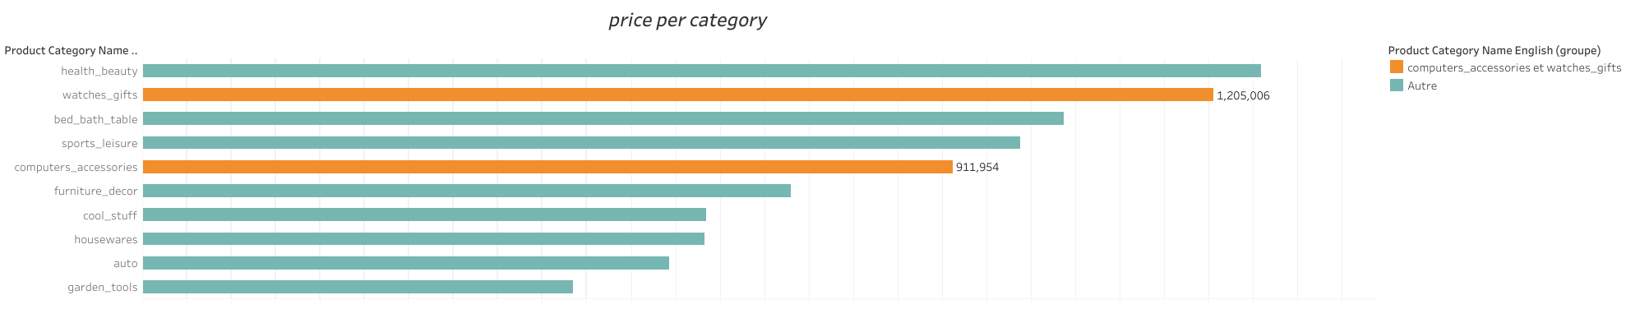

Slide 31
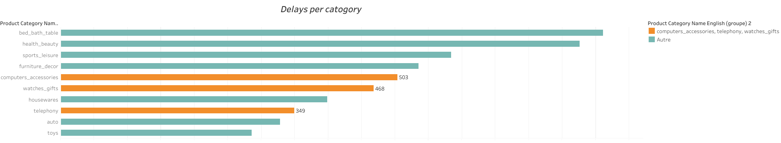

Slide 32
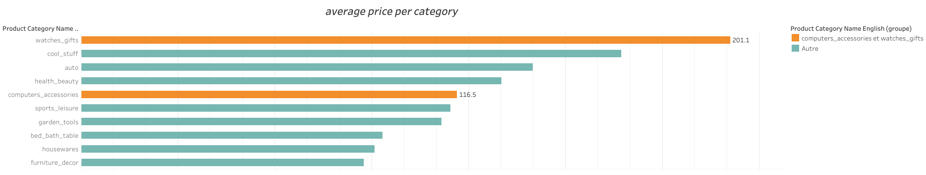

Slide 33


Slide 34
